Slide 1
DATA science basics

Slide 2
differences
Artificial Intelligence | Machine Learning | Data Science
Develops machines that simulate human thinking | Subset of AI, Computer systems learn from their surroundings and use it to improve processes | Processing and analyzing datasets, where the data is then used for future predictions and deployed to applications

Slide 3
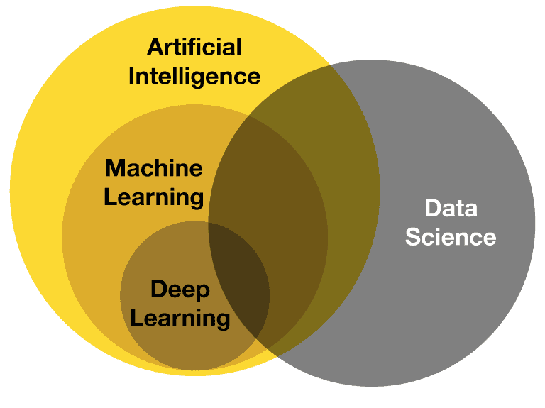

Slide 4
Real life application of AI
Robots
Digital assistant- siri, alexa, google assistant
Self driving cars

Slide 5
Real life application of ML
Image recognition
Medical diagnosis
Speech recognition
Prediction and classification

Slide 6
Real life application of data science
Healthcare industry
eCommerce
Banking and finance industry

Slide 7
Categories of ml algorithms
Supervised learning
Semi-supervised leaning
Unsupervised learning
Reinforcement learning

Slide 8
differences
Supervised Learning | Semi-Supervised Learning | Unsupervised Learning | Reinforcement Learning
Uses labeled dataset Used in classification/ regression problem Algorithms: Linear/logistic regression, SVM, K-means neighbors, Decision tree | Used both labelled and unlabeled data set | Unlabeled data Used in clustering and association Algorithms: K-means clustering, hierarchical clustering. | Defined rules and the machine uses a Trail and Error method to explore possibilities(reward based) Used in game development and robots Algorithms: Q-learning, monte carlo, Deep Q network.

Slide 9
Problem statement
Topic: prediction of customer churn rate on online poker due to the lift of covid-19 lockdown
Algorithm type: unsupervised learning-clustering techniques

Slide 10
process
Understanding the problem and goal
Data collection
Data preparation and preprocessing
Modeling and testing
Model deployment and monitoring

Slide 11
differences
Data Engineer | Data Analyst | Data Scientist | Machine Learning researcher | Machine Learning Engineer
Collection and storage of data | Perform Exploratory data analysis | Data Analyst + Model creation and deployment | A role assigned to a data scientist in charge of creating a ML algorithm(a hybrid model if necessary) | Focused on product deployment to the end users

